Slide 1


Democratising QGIS - and handy tips
George Corea, Data Manager, Mangoesmapping
FunGIS FOSS4G 2020, JCU Ideas Lab
20-11-2020
Notes:
Morning, thanks for joining us today.
I’m George and I’ve been involved with FunGIS for almost the last 10 years and it’s great to bring FOSS4G up here.
About 4 years ago we organised a QGIS workshop – ‘GIS in the Open’ and since then we’ve continued to have a lot of open source content.
‹#›

Slide 2

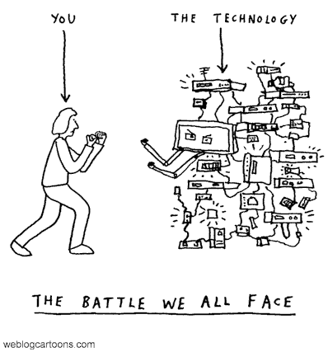
Notes:
Over the last few years I’ve been involved with the Startup world and helped build the scene in the Tablelands and presented at many events in Cairns and Brisbane.
Through that (and now working in a start-up) I have been exposed to the importance of a focus on clients. It’s not my wheelhouse, I don’t naturally think about the end users but it’s essential and a key battle we face. It directly impacts the value of our work.
‹#›

Slide 3


For End Users - non-GIS/non-technical individuals…
Do they find it…
Too complicated?
Simplified tasks?
SQL without knowing SQL?
This PhotoThis Photo by Unknown Author is licensed under CC BY-SA
Notes:
Think about this image!
In this virus age, sometimes using desktop GIS for non-GISsers is like dissecting a genomic sequence for us. As simple as GIS may seem to us, it’s complex, scary and daunting to many.
These are the questions we must ask ourselves on their behalf
is a standard GIS desktop environment too complicated?
are there many common tasks that can be simplified?
can they use SQL queries without knowing SQL?
.
‹#›

Slide 4

For administrators…
The questions we must ask are…
No/Low Code?
content management system?
mobile devices, off-line and online?
non-technical and technical?
This PhotoThis Photo by Unknown Author is licensed under CC BY-SA
Notes:
As important as the users are, we also need to consider the Administrators of our systems…for them we need to ask the following questions.
is changing the user environment a complex task that requires significant code level changes?
can it be changed using a content management system similar to a website?
can it be used on mobile devices, off-line and online with minimal rework?
Is there a single system that non-technical and technical GIS users can use?
These are the questions I hope I can answer in the next half hour.
‹#›

Slide 5

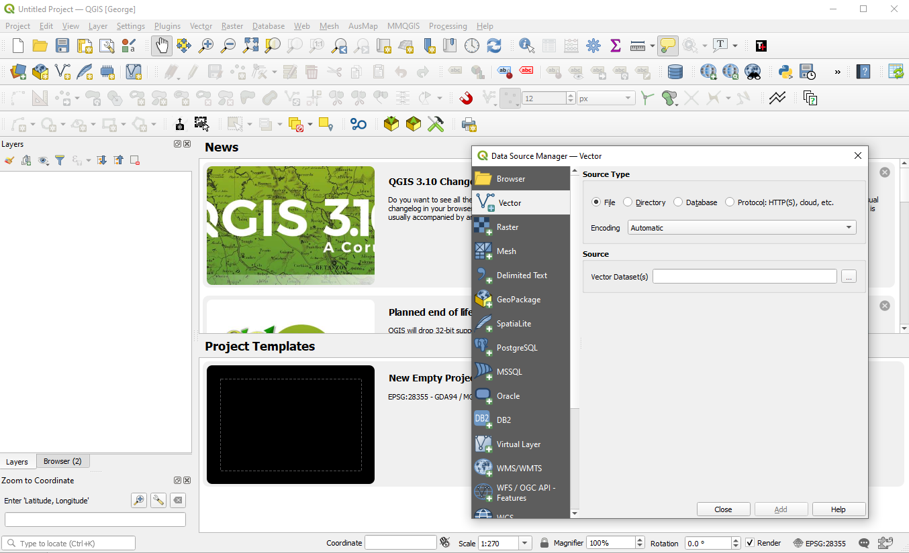
Standard – For Naive End Users
Is it…
Complex?
Many options?
Many steps?
Functional and adaptive?
This is not significantly different in commercial GIS software
Notes:
When we look at QGIS or any other commercial GIS system through the eyes of people who don’t have our background –it actually seems
Quite complex and daunting to non-technical users
Many options that need to be configured
Takes many steps to add new data
Very functional and adaptive for technical users.
DEMO
Open QGIS in default state
Add a raster/vector dataset
Show changing panels and settings
‹#›

Slide 6
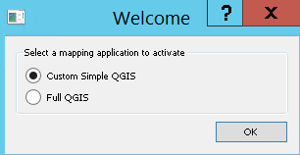
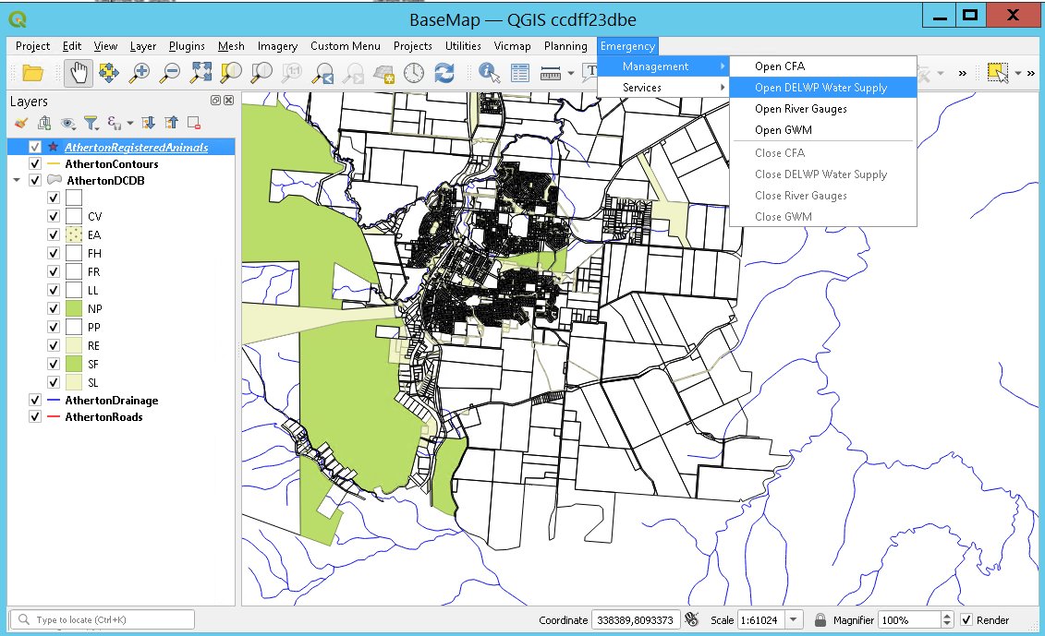
Custom QGIS
Simple choice of experience
Load a standard map
Add menus for Imagery, Projects, Assets etc that load groups of layers
Simplify closing opened layers
This is also available in MapInfo through our custom code base.
Notes:
The concept behind the Mangoesmapping ‘Custom Menus’ plugin was to have a single spreadsheet like table that could be edited to update the menus, data that’s loaded and the associated symbology without having to access the code base.
This reduces implementation and administration time quite significantly and democratises access to changing the interface to trusted team leaders who could easily create and update an interface for their teams.
DEMO
Open QGIS using custom vbs
We can add projects here so that Townplanning, Customer Service, Engineering divisions could see different interfaces tailored to there unique needs.
Demonstrate standard opening map
Show adding a layer
Show closing a layer
Show running a SQL search – search for ‘main’ in the road table
Show running ‘f main’ and complexity of returned result
‹#›

Slide 7
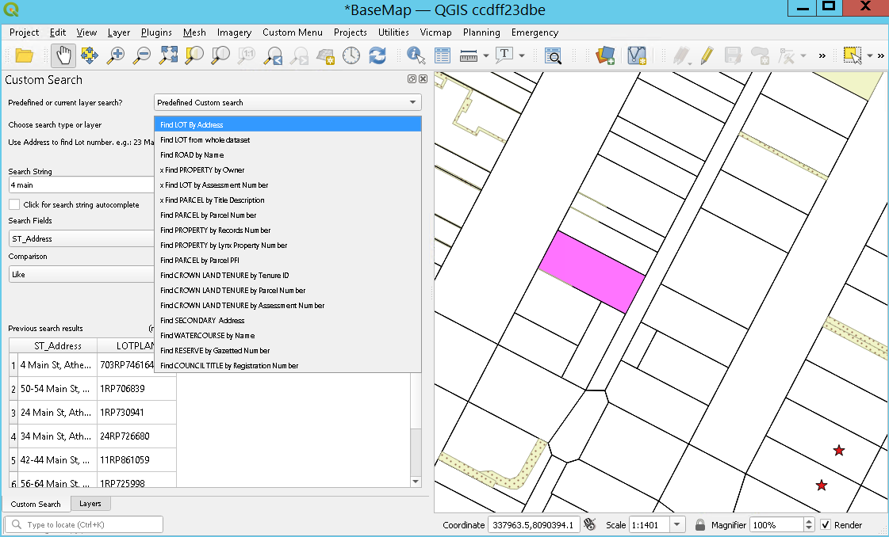
Custom Search
Choose predefined searches with results tailored to your needs.
Use autocomplete to start searching
Customise the search further if required setting the fields to inquire in and the comparison
Click on a result to zoom into the feature
Spatial (within, intersect) searches are being added
Similar functionality is available in Mapinfo through our custom code base.
Notes:
The MGM search plugin is based on the open source ‘Search Layers’ plugin. Our clients needed to be able to search specific fields in GIS tables and SQL views to get results that only included some fields.
This is relatively easy in SQL but very complex for non-technical users.
Our plugin integrated these needs.
DEMO
lot by address to show simple result –use ‘main’
whole dataset to show difference – use ‘main’
Change settings and run search – use autocomplete and click on drop down
Run full search (native plugin)
Delete all layers and run query – this will show that data will be added if required.
‹#›

Slide 8
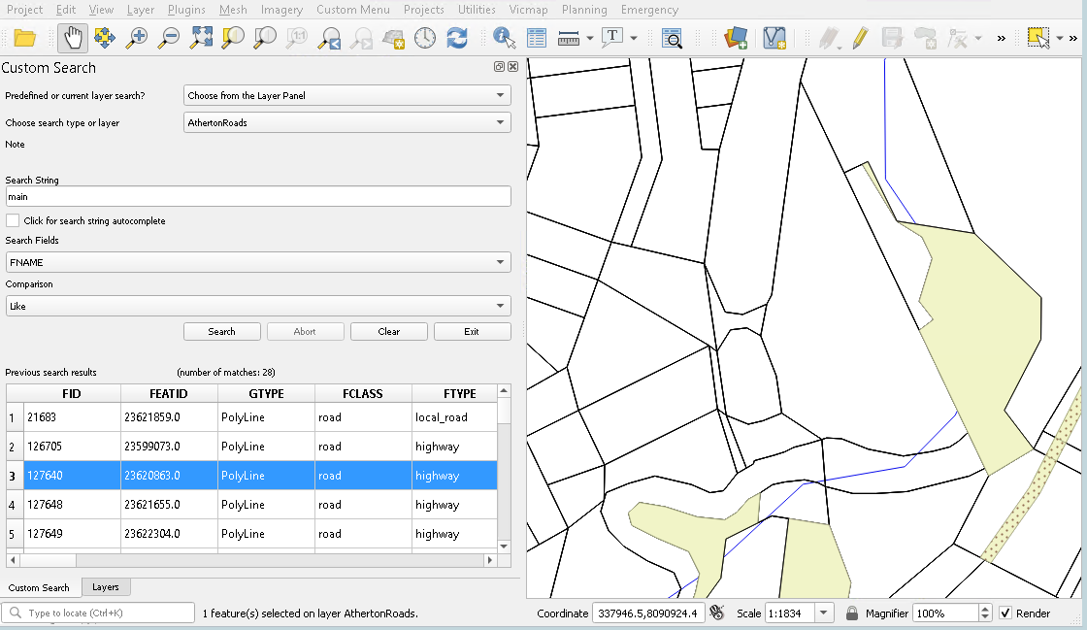
Search Layers
The open source plugin allows intuitive but powerful search options
Notes:
DEMO
Search for main in Roads dataset
‹#›

Slide 9

Administration
This PhotoThis Photo by Unknown Author is licensed under CC BY-SA-NC
Notes:
We’ve looked at the user experience for both Non-Technical and Technical users. The other critical piece to a corporate solution though is the IT team and Administrators.
So how easy is it for the administrator to change what people see and can do?
‹#›

Slide 10
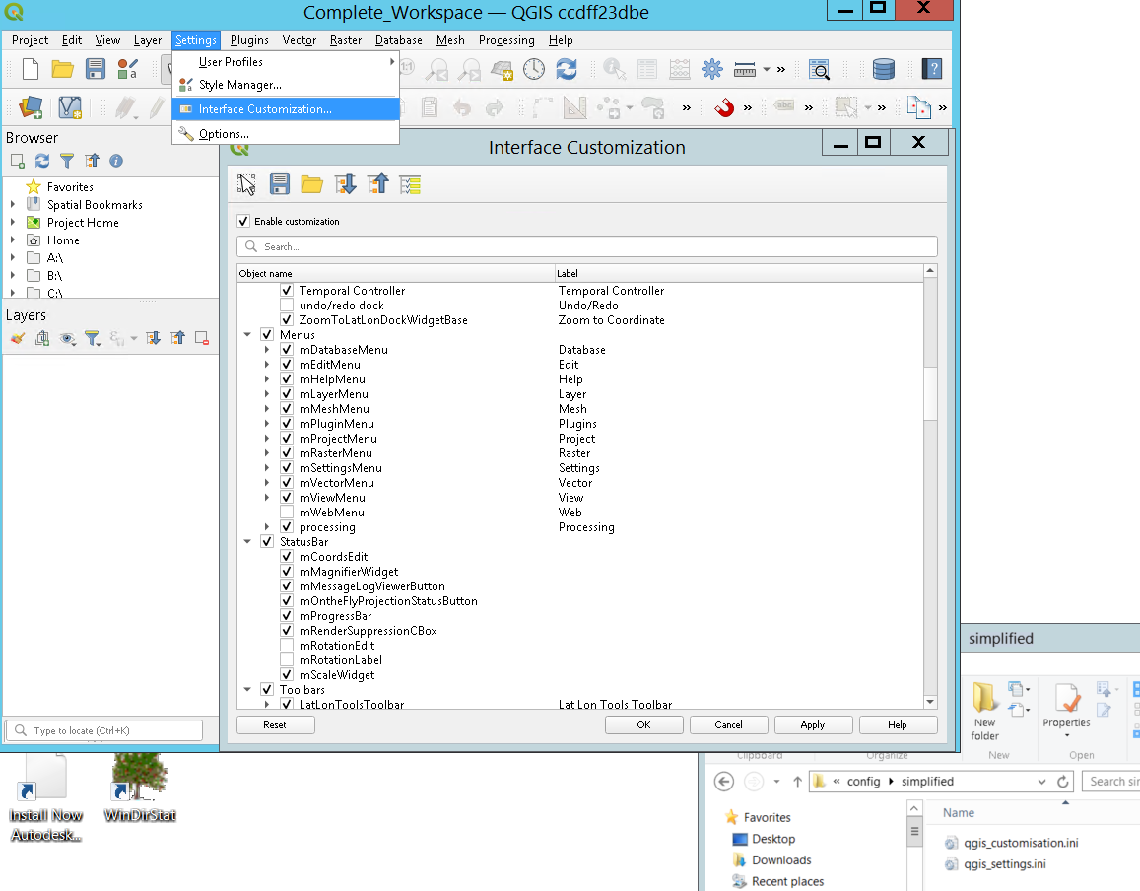
Change the UX
Admins use the QGIS interface customization tool to save the required config into a custom folder
Our system will then use this every time a user opens the custom simplified (or full) interface.
Notes:
While there are processes to change the UI/UX of QGIS that are built in, they can be difficult to implement at a corporate level.
DEMO
Open the Interface customization and show the level of control available
Show it saves in the user profile ‘\Roaming\QGIS\QGIS3\profiles\default\QGIS’
Show behind the scenes in dealing with the different profiles
‹#›

Slide 11
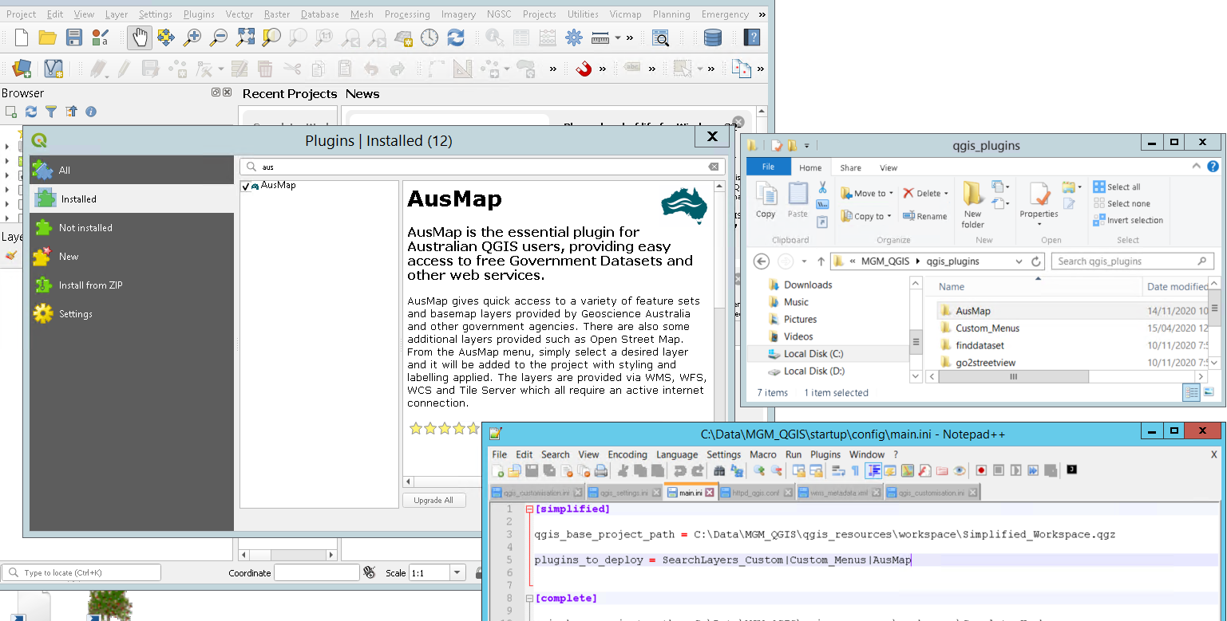
Install Plugins
Notes:
We as GIS professionals (trained operators) want to be able to add tools, create workflows and customize the system to our individual needs.
We as IT Managers want to be able to restrict individual customization as much as possible to reduce security risks and make processing updates easier.
The process we have developed allows for a balance to be met.
Admins install plugins as usual
Copy the plugin folder to a restricted folder
add settings to 3 key files that control the behaviour for all users every time they open the custom interface.
‹#›

Slide 12
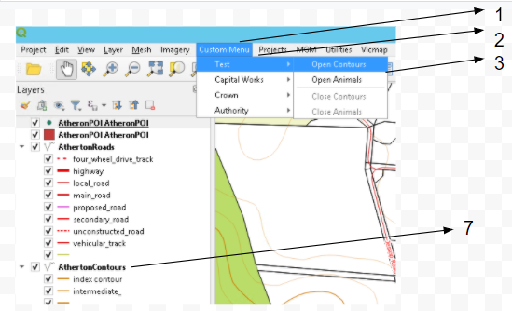
Add / Modify Menu items
Field 1 = Custom Menu
Field 2 = Test
Field 3 = Contours
Field 4 = \\PROD\GIS\Data
Field 5 = Contours.shp
Field 6 = Contours.qml
Field 7 = Contours
Field 8 = (blank) –for database views
Field 9 = (blank) –for Web Services
Field 10 = ogr
In the configuration file, each line represents a menu item, in a 10-fields comma-separated distribution, as exemplified below:
Custom Menu,Test,Contours,\\GIS\Data,contours.shp,contours.qml,Contours,,,ogr
Notes:
‹#›

Slide 13
Add / Modify Menu items
Field Name | Description | Mandatory Field
Field 1 | Name of the first level menu item | YES
Field 2 | Name of the second level menu item | YES
Field 3 | Name of the third level menu item | YES
Field 4 | System full path of the directory where the target GIS dataset is saved | YES
Field 5 | Name of the target GIS dataset (a file name). This can be any vector dataset (ShapeFile, TAB file etc.) or any raster dataset (ERS/ECW, GeoTIFF etc.) | YES
Field 6 | A QGIS styling file (QML file) to be applied to the target GIS dataset when loaded as a QGIS layer. The QML file has to exist in the same directory declared in Field 4. Leave field blank if no custom styling is required for the layer. | NO
Field 7 | Name used for the layer holding the target GIS dataset | YES
Field 8 | Reserved field. Leave it blank. This will hold queries and database table views | NO
Field 9 | Reserved field. Leave it blank. This will hold server info for WMS/WCS layers | NO
Field 10 | QGIS layer type. Use “ogr” for vector layers and “gdal” for raster layers | YES
A third level menu can be configured to load more than one GIS dataset layer in QGIS.
In that case, fields 1, 2 and 3 will repeat. Fields 4, 5, 6, 7 and 10 will hold different values.
Notes:
DEMO
Open the csv in ‘\qgis_plugins\Custom_Menus’
Add some menu items
Reopen the simple QGIS
‹#›

Slide 14
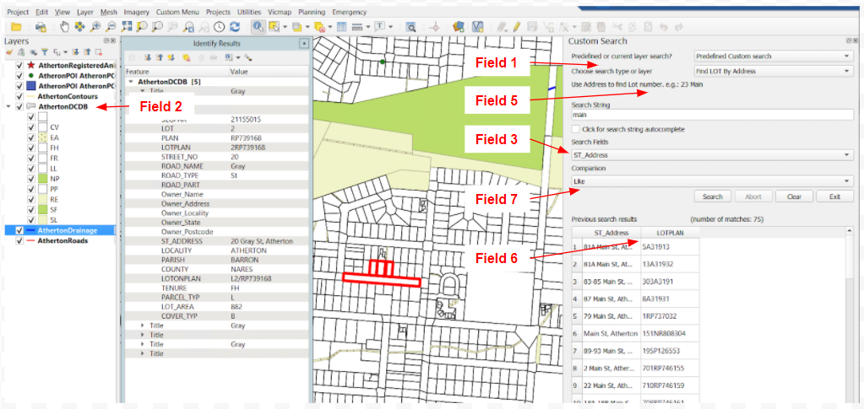
Custom Search
Field 1 = Find Lot by Address
Field 2 = AthertonDCDB
Field 3 = ST_Address
Field 4 = Cadastre\AthertonDCDB.tab
Field 5 = Use any Road Name. e.g Main
Field 6 = ST_Address^^LOTPLAN
Field 7 = Like
In the configuration file, each line represents a pre-configured search option, in a 7-fields comma-separated distribution, as exemplified below:
Find LOT By Address,Parcel,ST_Address, Cadastre\AthertonDCDB.TAB,Use Address to find Lot number. e.g.: 23 Main,ST_Address^^LOTPLAN,Like
Notes:
‹#›

Slide 15

Custom Search
Field Name | Description | Mandatory Field
Field 1 | Name of the predefined search option | YES
Field 2 | Name used for the layer holding the target GIS dataset | YES
Field 3 | The name of the attribute in the target GIS dataset in which the search will be executed | YES
Field 4 | System full path of the file representing the target GIS dataset. This dataset will also be loaded as a QGIS layer. It should reference a vector dataset (ShapeFile, TAB file etc) | YES
Field 5 | Predefined search option description. Ideally, this field should contain a short note highlighting specific usage recommendations for the selected search option | YES
Field 6 | List containing all attribute names from the target GIS dataset that will be displayed in the search results table. When displaying more than one attribute, please use “^^” between the names in the list. When left blank, only the attribute in field 3 will be displayed in the search results table | NO
Field 7 | The default comparison operator used in the search option. Allowed values are “Like”, “Equals” and “Starts With” | YES
Additional Functionality - Currently being tested and planned.
Ability to set the zoom level per search result
Icon displaying timing of result especially for large datasets.
Full SQL search with geometry
Notes:
DEMO
Open ‘\qgis_plugins\searchlayers_custom’
Add some new search queries and change the results
‹#›

Slide 16
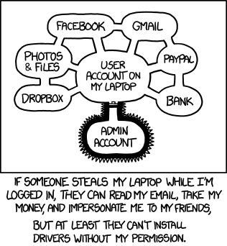
Permissions and Security
This PhotoThis Photo by Unknown Author is licensed under CC BY-SA
Notes:
The system will be tailored to your needs.
Some clients have a
production and master store where every night or week data is moved from master to production and no one can write to production and GIS staff can edit master.
Only a GIS Library where people work in projects and then GIS Administrators copy the files to production manually.
Databases which QGIS can access with the users permission on the UAC.
The QGIS version available can be edited to remove edit tools from users based on their permissions and/or the version they choose on startup.
The versions can load editable (non-production) data depending on the current users requirements
Our system will adapt to these and other needs as required.
‹#›

Slide 17

How does it work in a mobile environment?
Notes:
Another common issue (we see often in tender applications) is creation of a system for mobile and online, offline. QGIS mobile (Qfield) allows this when used with GeoPackage layers and QGIS Server allows the web interface.
‹#›

Slide 18
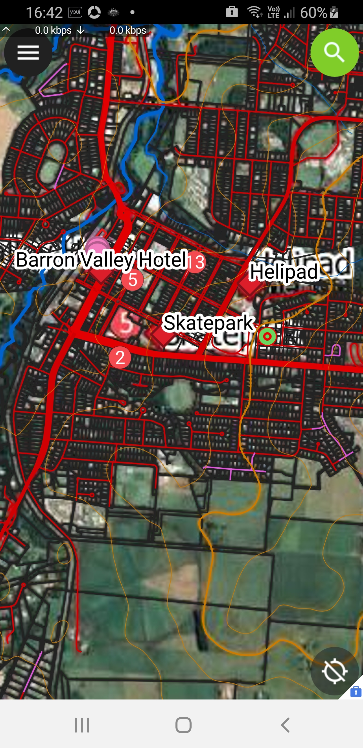
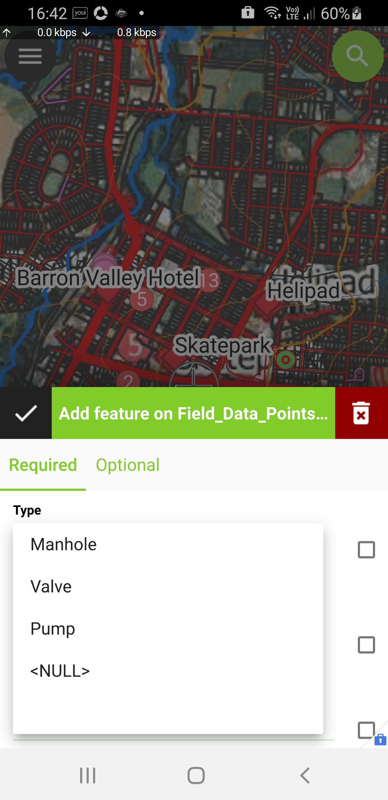
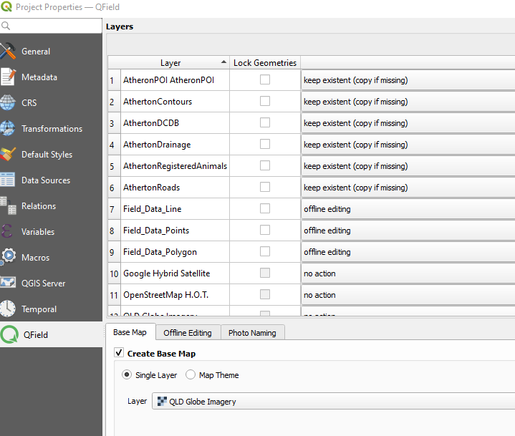
Notes:
DEMO
Show QGIS mobile project and QSync
Sync using GSync
Open QField and
Add point data –show drop downs, UID and photo
Add line data –show auto GIS length
Sync back
Show updated data on desktop
DISCUSS
Syncing multi-user data : currently only latest version would be accepted, for full multiuser edit and caching/conflict resolution an online database needs to be used.
Issue with Tab data and workaround
GPS Tracking being worked on by the creators
From the Perth Hub see https://www.youtube.com/watch?v=1vkeLQADgR4
‹#›

Slide 19
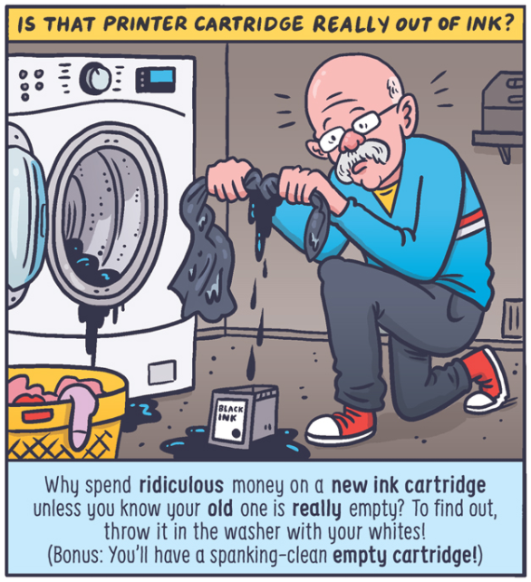
Handy Tips
Notes:
I want to share some tips on using QGIS for data collection and editing – let me know if they are as valuable as above.
DEMO
Open Full QGIS
Show the actions of adding point and line data – focus on the prefilled/drop down list functionality
Show the code behind the different functions
Creating drop down forms
Connecting points to lines for less coding
Extracting data from one file to another
BONUS –if there’s time.
Running complex queries (use CSC Roads)
END
So what do you think? Is this as useful as advise to put your ink cartridge in the washer?
‹#›

Slide 20

Notes:
Thanks for your time, let us know if you have questions
‹#›

